Slide 1
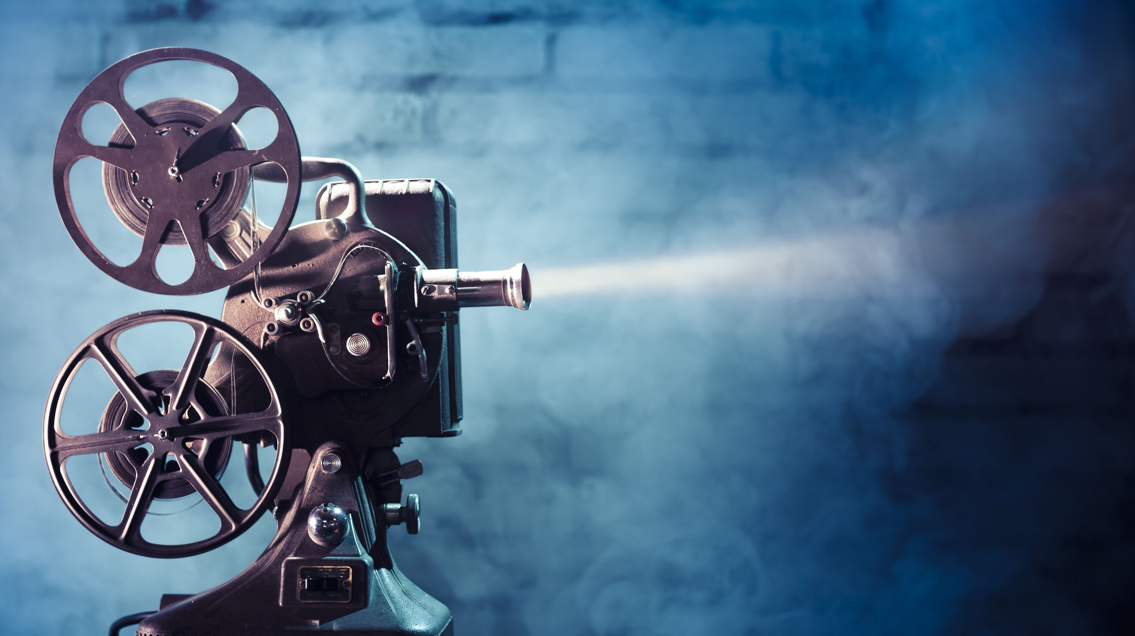
Movie Time
Jinal Jain | Mihir Sawant | Umesh Nair | Manasee Godsay | Rushikesh Naidu

Slide 2
THE FOLLOWING PREVIEW HAS BEEN APPROVED FOR
ALL AUDIENCES
BY MOVIETIME ASSOCIATIONS.INC
PG-60 | SIT BACK AND ENJOY
SOME MATERIAL MAY BE INAPPROPRIATE FOR CHILDREN UNDER 60
INTENSE ANALYSIS & DRAMA

Slide 3
Definition of Popularity

Slide 4
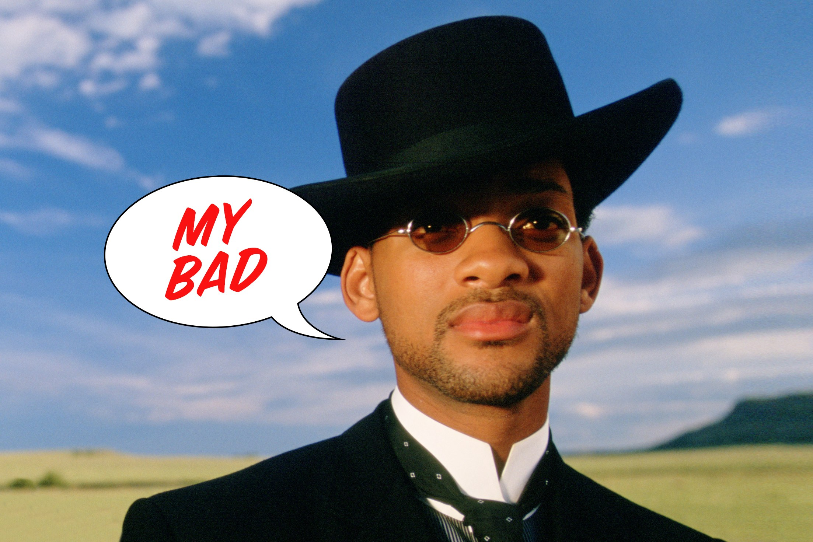
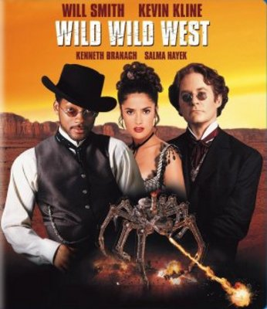


Slide 5
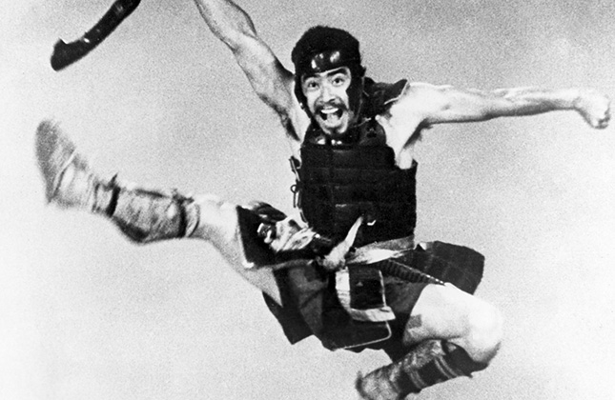
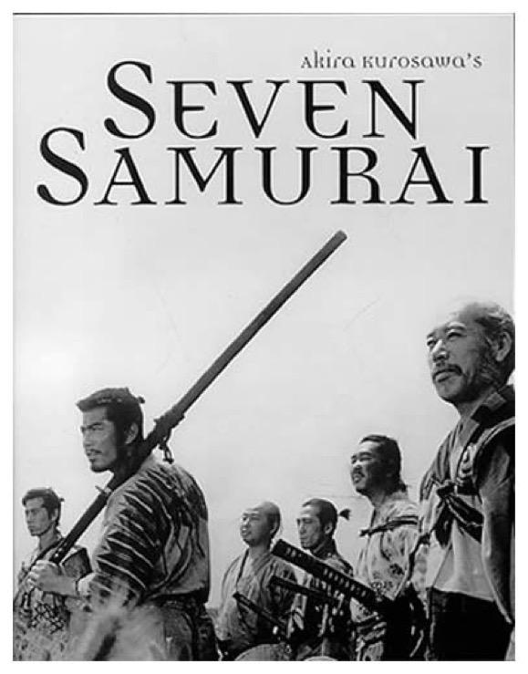


Slide 6
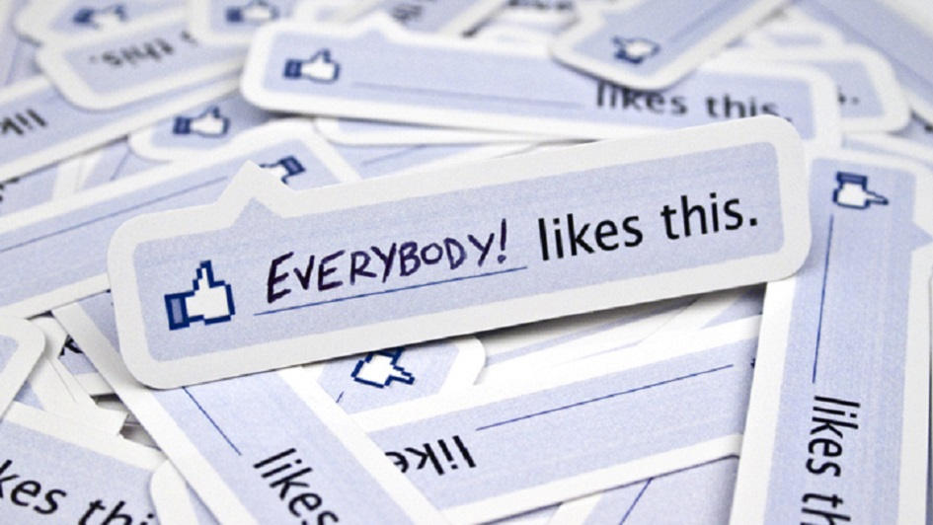
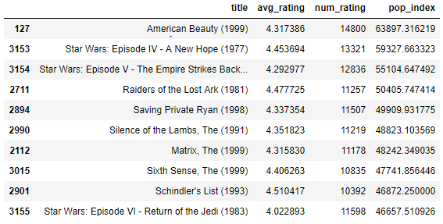
Popularity Index
Popularity Index is the Average Rating multiplied by the Total number of ratings a movie receives.
This gives movies with smaller number of ratings but higher average ratings appear among the most popular movies .

Slide 7
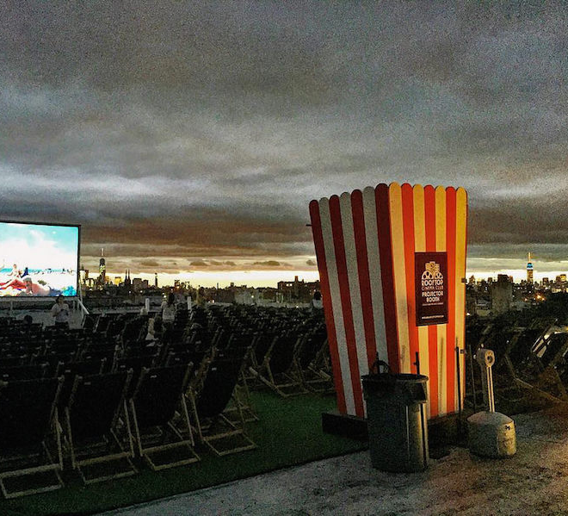
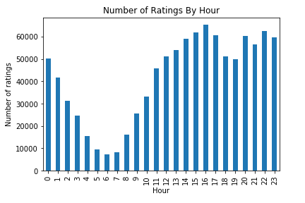
Basic Analysis On Data _______________
Most of the users view movies at night.

Slide 8
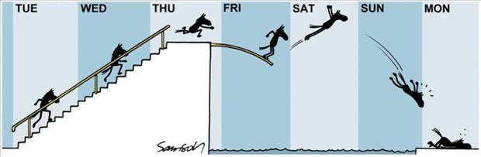
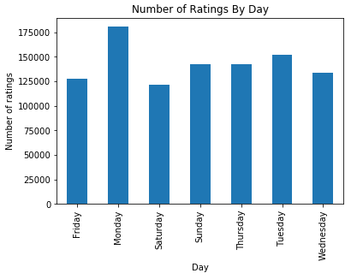
Most of the users view movies at night.

Slide 9
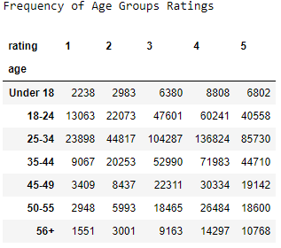
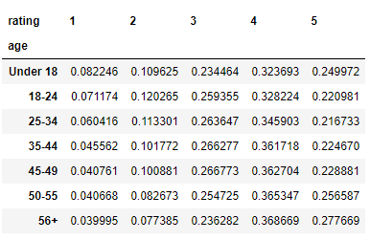
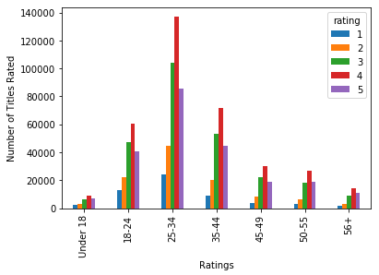
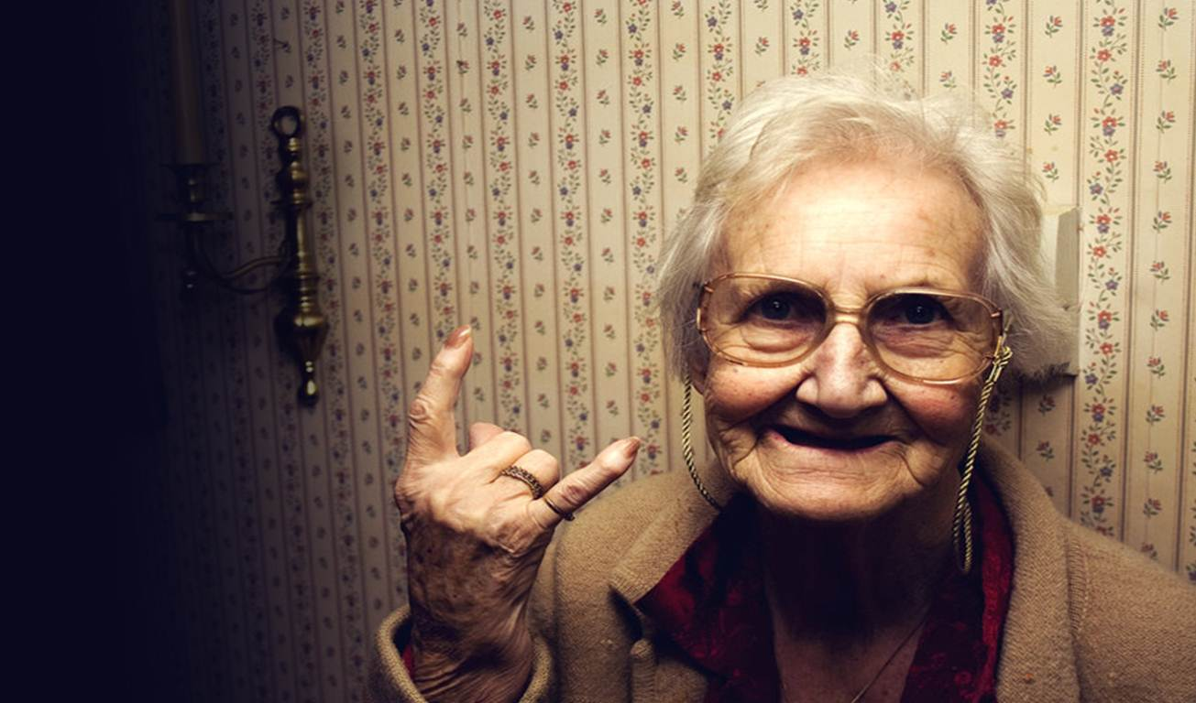
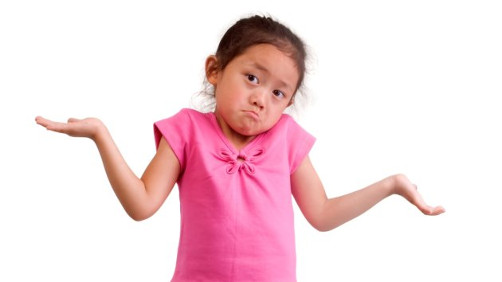
Conjecture 3: Users over the age of 50 are easier to please
Percentage Distribution of Rating
Distribution of Rating

Slide 10
Distribution of Data

Slide 11
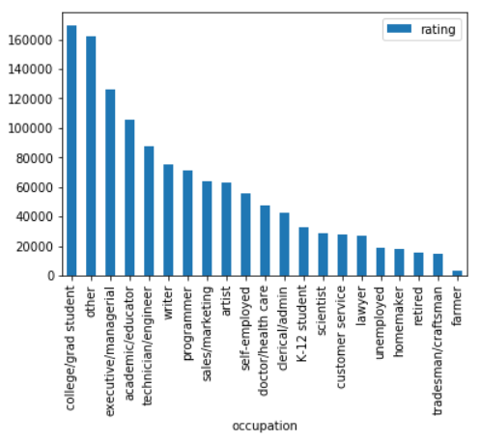

Scientists like comedy movies.
Yes , they have an average rating higher than any other occupation
Number of Ratings
Popularity Index

Slide 12
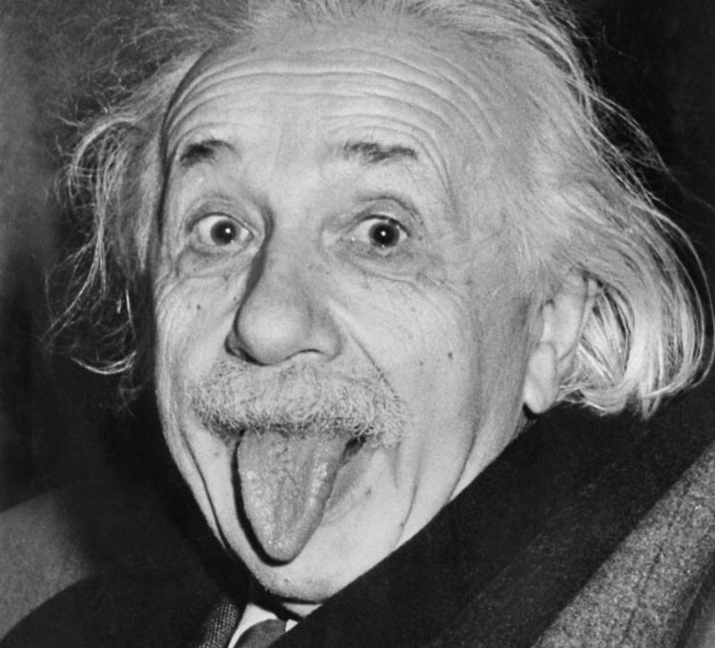
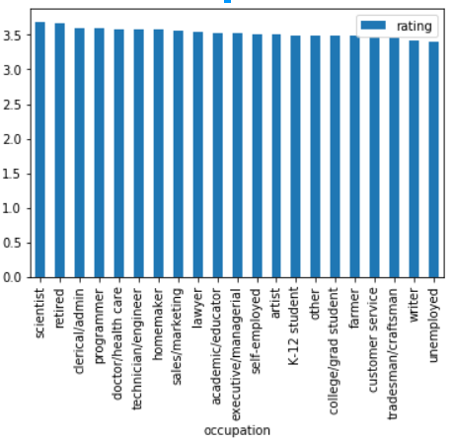
Average Ratings

Slide 13
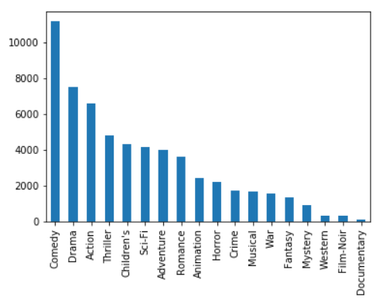
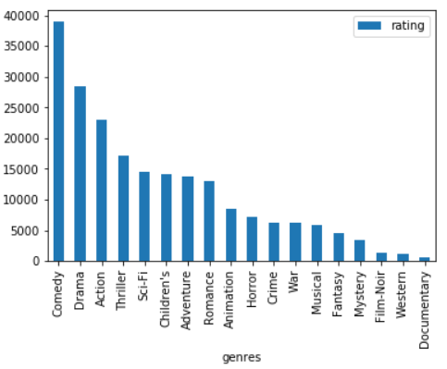
Users under 18 years of age prefer Children’s, Animation and Sci-Fi movies
Number of Ratings
They prefer Sci-Fi over Children’s Movies
Sum of Ratings

Slide 14
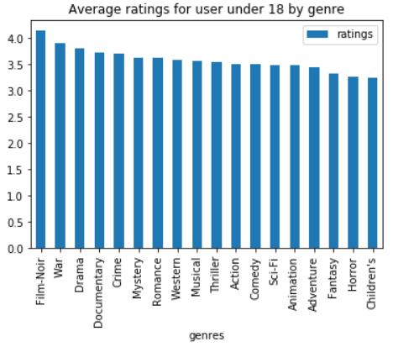
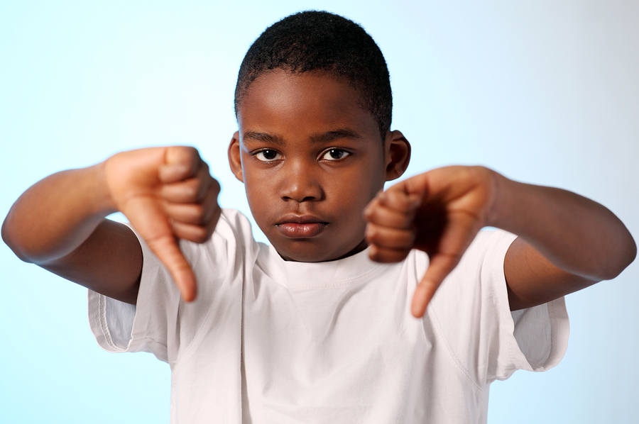
Average Ratings

Slide 15
Men versus Women

Slide 16
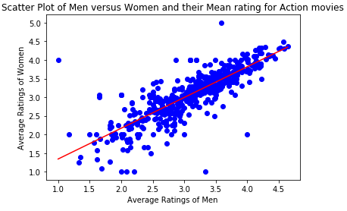
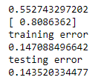
Can we predict the ratings of Action movies given by women looking at the ratings given by men
Corr. Coeff – 0.8211
Dividing the dataset into training set ( 70% ) and test set (30%) :
Thus we can predict ratings given by women using ratings given by men with 14% error.

Slide 17
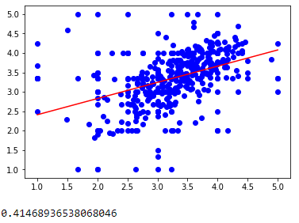
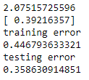
Can we predict ratings given by women in the age group 18-25 for Romance movie looking at the men's ratings
Corr. Coeff -
Dividing the dataset into training set ( 70% ) and test set (30%) :
This shows that we cannot predict ratings given by women using ratings given by men.

Slide 18
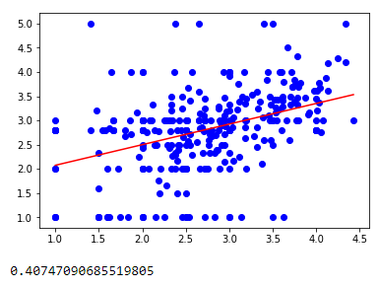
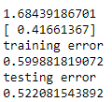
Can we predict a female grad student rating for a horror movie based on a male grad student rating?
Corr. Coeff -
Dividing the dataset into training set ( 70% ) and test set (30%) :
Since the test error is so high, we cannot predict female grad ratings from male grad ratings for Horrror movies

Slide 19
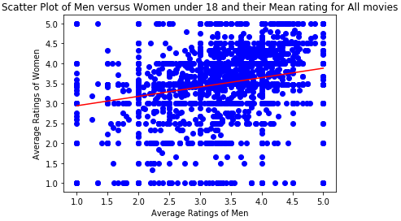
Men and women have similar preferences when they're younger
Correlation Coefficient – 0.2454
They don’t have similar preferences when they are younger

Slide 20
Men and women have similar preferences when they're older
Correlation Coefficient – 0.4287

Slide 21
Business Plan

Slide 22
Recommender System for new users
What genre of movies should MovieTime suggest to a new user?
The question is too broad to answer

Slide 23

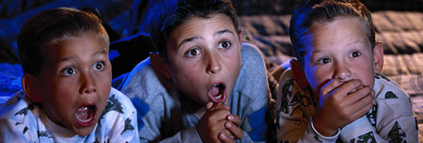
Making it specific by dividing the question amongst “Working” and “Non-working users”
Remaining were considered as “Working”
“Non-working” includes occupations: homemaker, college/gradstudent, retired, unemployed and K-12 student

Slide 24
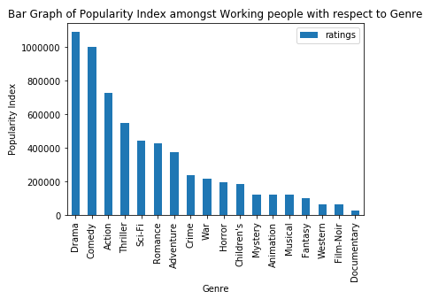
What kind of movies is watched by Working users?

Slide 25
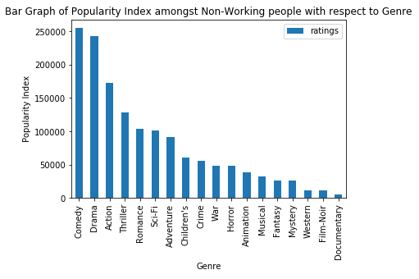
What kind of movies is watched by Non-working users?

Slide 26
Recommendations:
Drama movies should be recommended more to working users
Comedy movies should be recommended more to non-working users
Children’s movies are more popular among non-working users
Mystery movies are more popular among working users

Slide 27
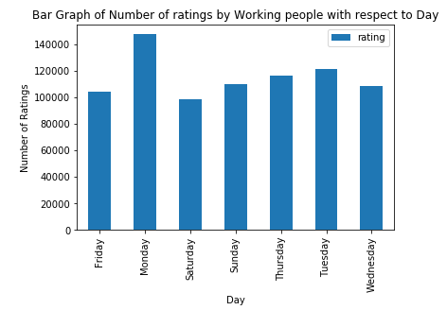
What is the best day of the week to recommend movies to working users?

Slide 28
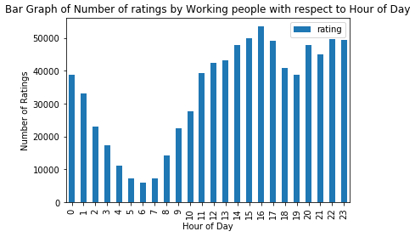
What is the best time of the day to recommend movies to working users?

Slide 29
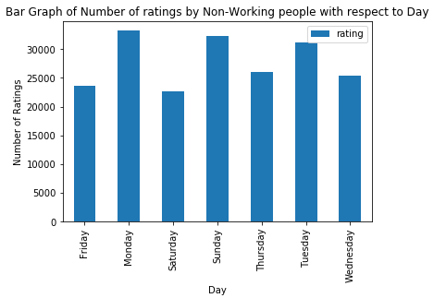
What is the best day of the week to recommend movies to non-working users?

Slide 30
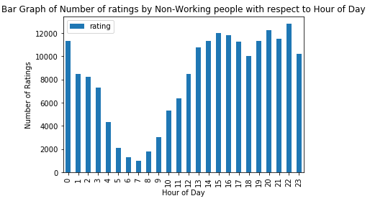
What is the best time of the day to recommend movies to non-working users?

Slide 31
Recommendations:
Monday → Tuesday → Thursday
Best Day of the Week for working users
3:00 PM – 5:00 PM
Best Time of the Day for Working Users
Monday, Sunday and Tuesday
Best Day of the week for non-working users
8:00 PM – 10:00 PM
Best Time of the Day for Non-working Users

Slide 32

Thank You

